Slide 1

CHINESE REMAINDER THEOREM
Group members:
QASIM HASAN (21K-3210)
AHSAN ASHRAF (21K-3186)
SUFIYAAN USMANI (21K-3195)
SHAHMIR RAZA (21K-3158)
YOUSUF AHMED (21K-3186)

Slide 2
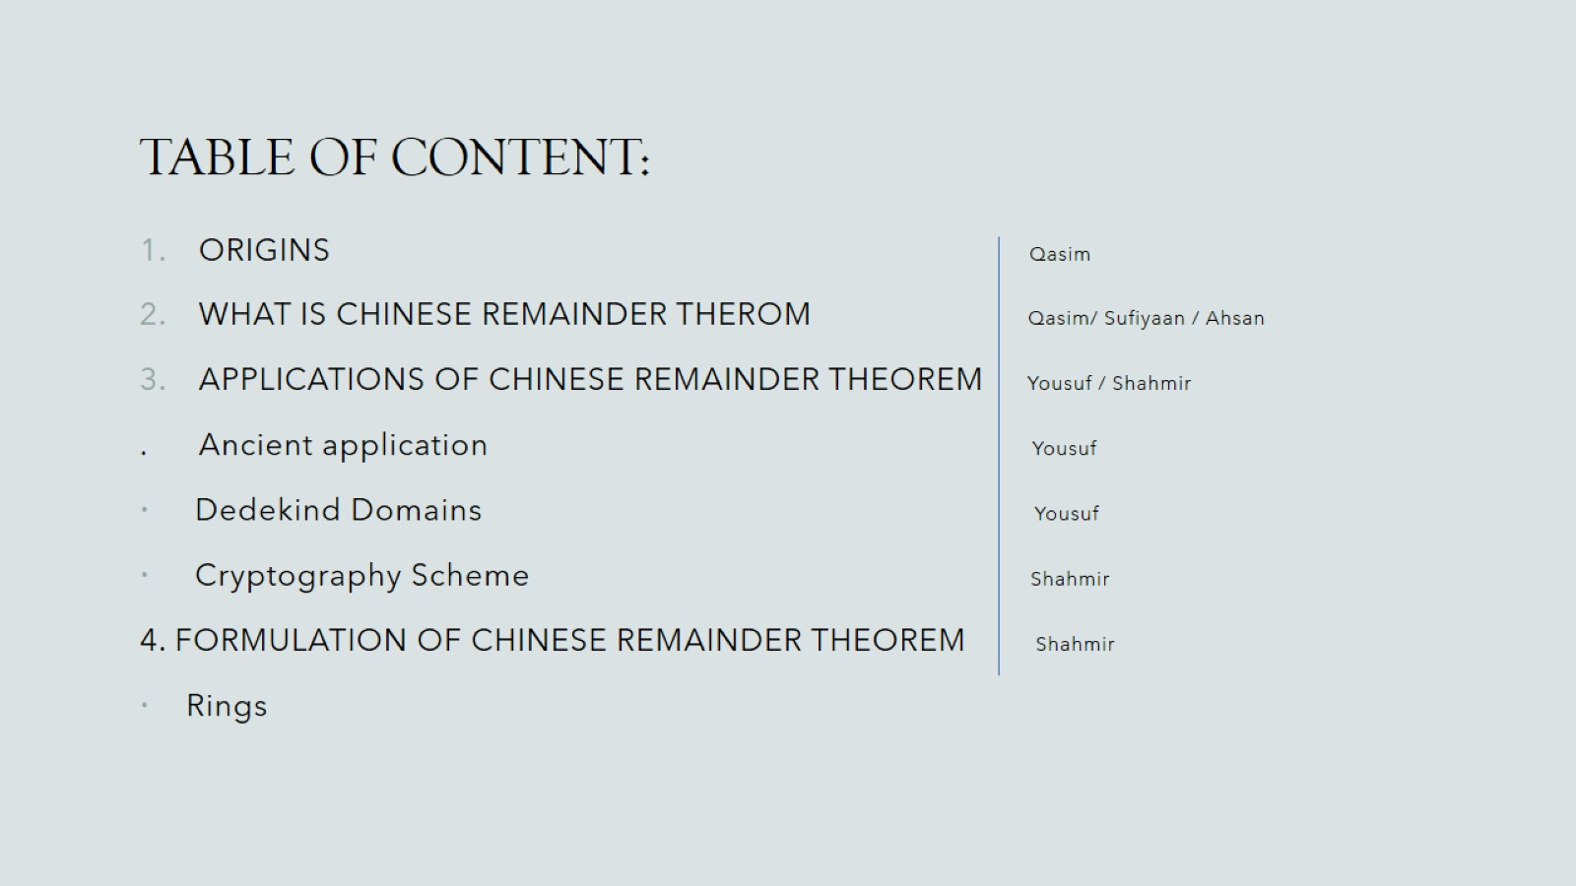
TABLE OF CONTENT:

Slide 3
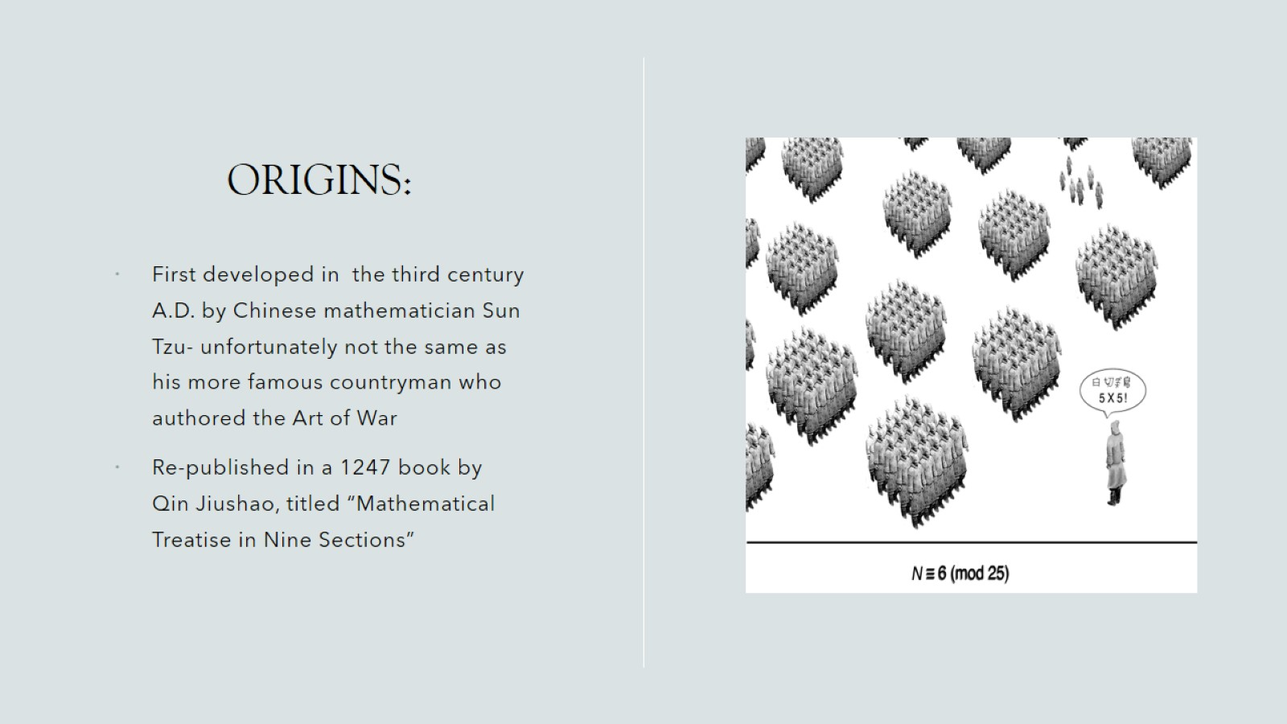
ORIGINS:

Slide 4
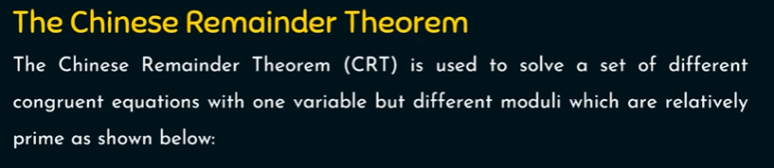

Slide 5
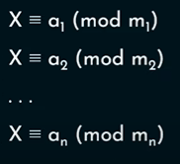

Slide 6
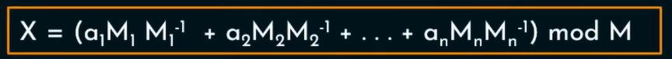

Slide 7
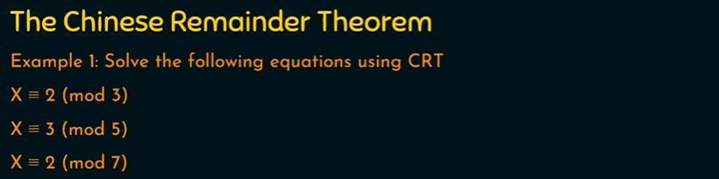

Slide 8


Slide 10
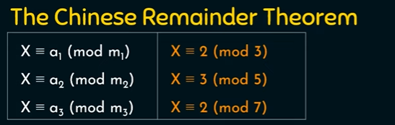

Slide 12
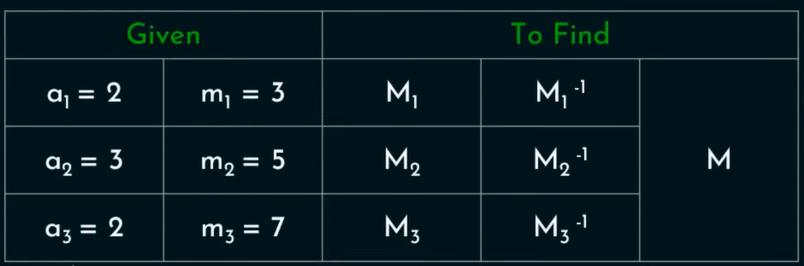

Slide 15


Slide 16


Slide 17


Slide 18
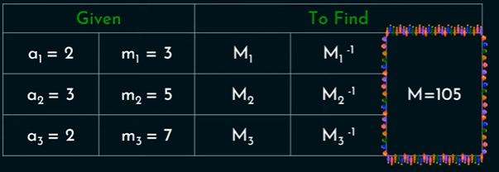

Slide 19
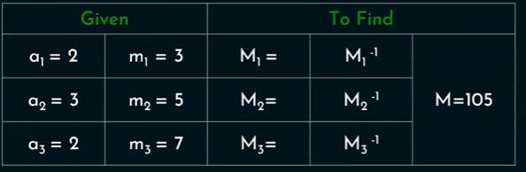

Slide 21


Slide 22


Slide 23


Slide 24


Slide 25


Slide 26


Slide 27
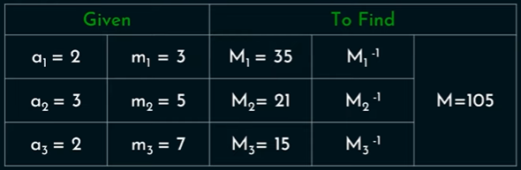

Slide 28




Slide 29


Slide 30


Slide 31


Slide 32
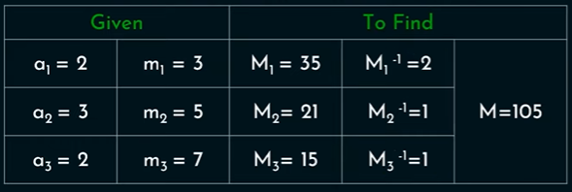

Slide 36


Slide 37


Slide 38
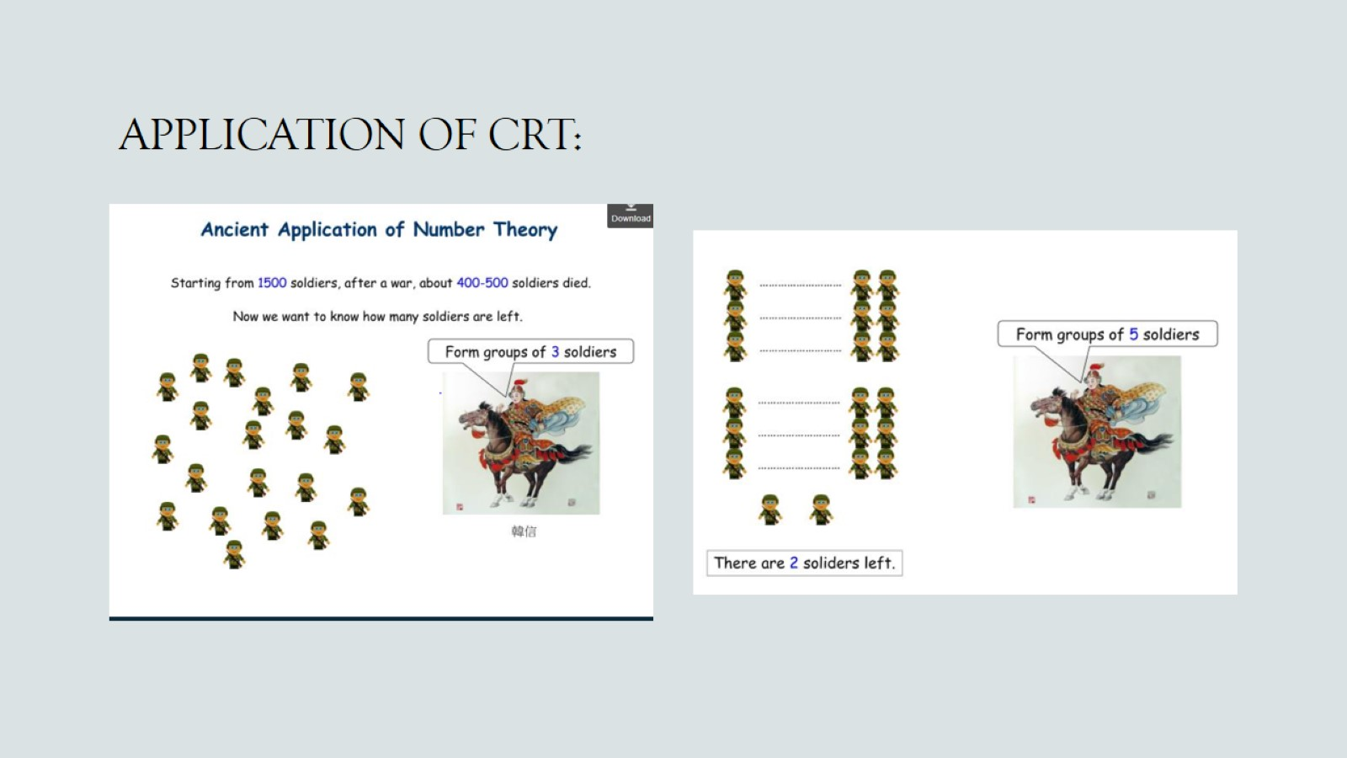
APPLICATION OF CRT:

Slide 39
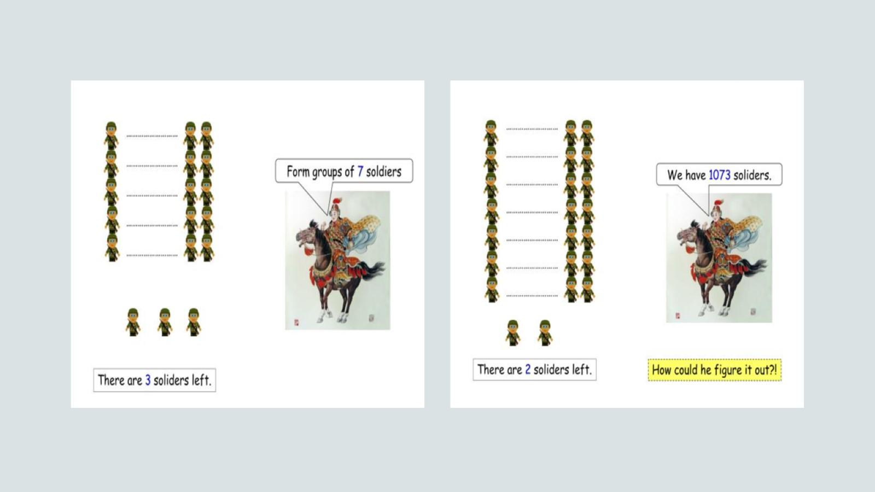

Slide 40
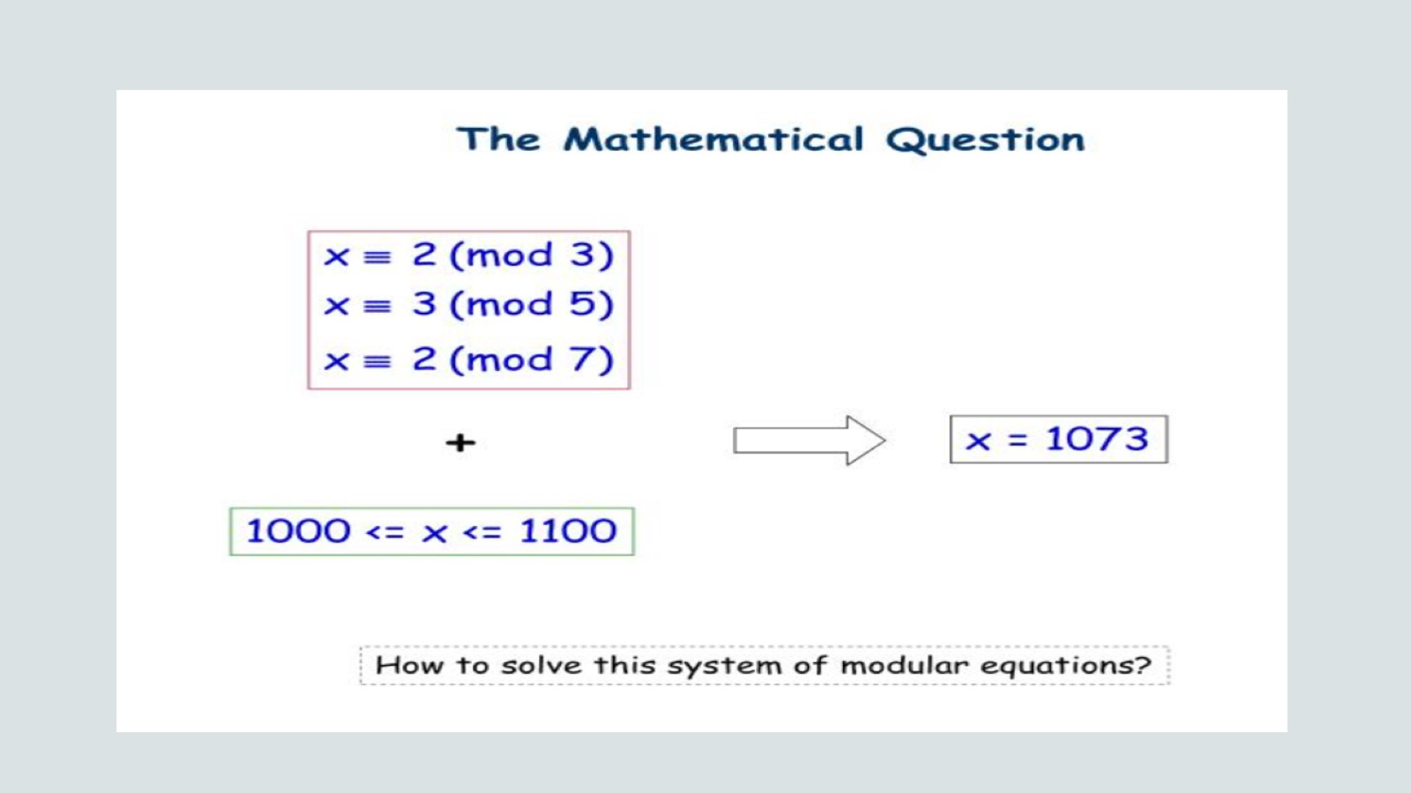

Slide 41
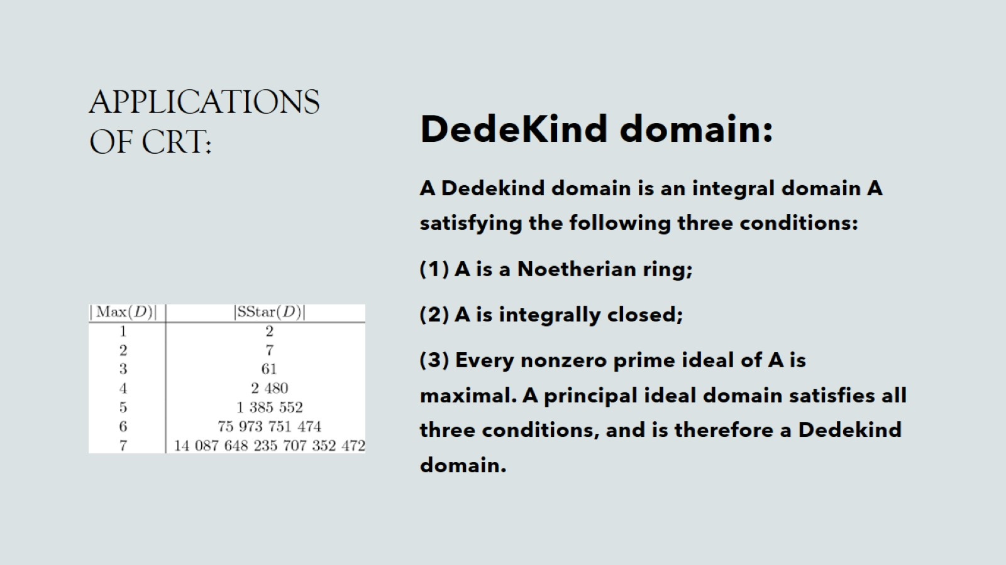
APPLICATIONS OF CRT:

Slide 42
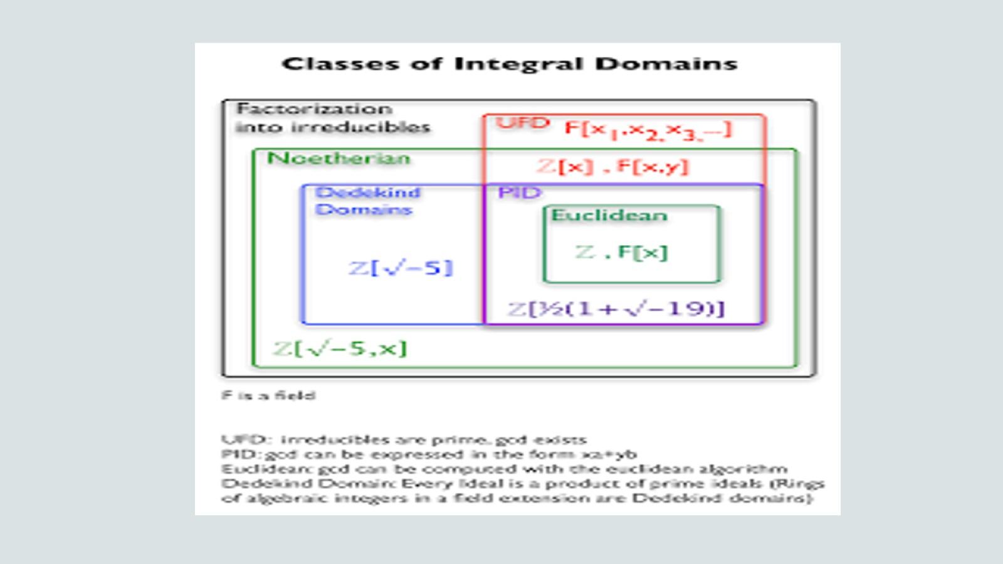

Slide 43
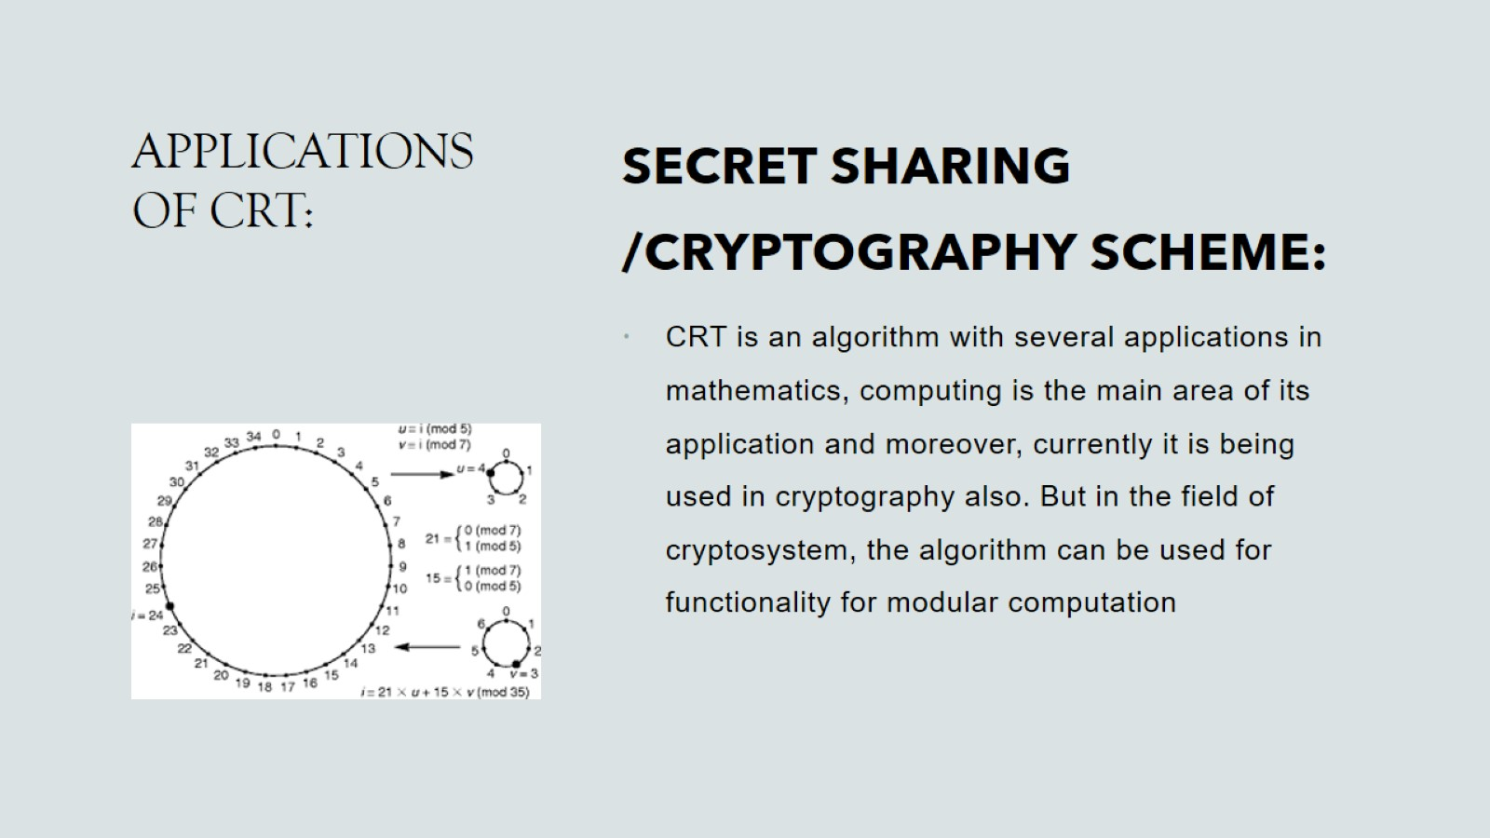
APPLICATIONS OF CRT:

Slide 44
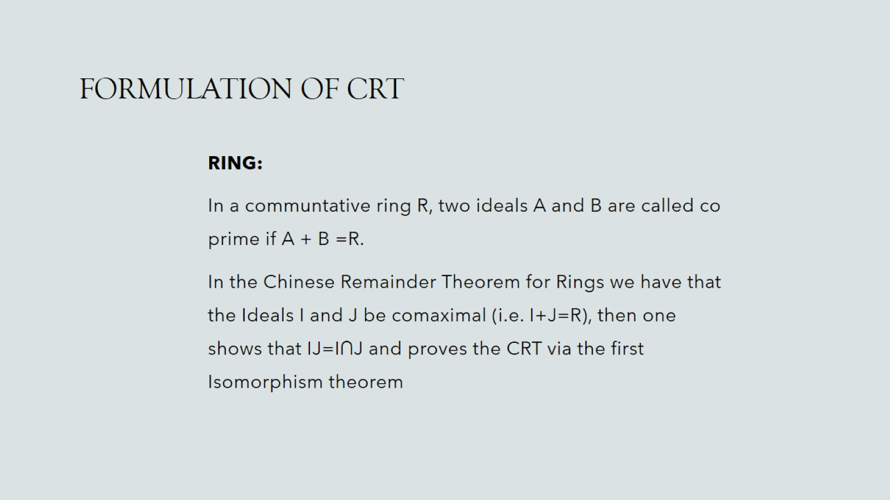
FORMULATION OF CRT

Slide 45

FORMULATION OF CRT
CONCLUSION:
We have Covered the Origins of CRT
We have Covered What is CRT
Solved A CRT
Showed Application of CRT
Showed Formulation of CRT

Slide 46


